Slide 1
CpE111
Introduction to Computer Engineering
Dr. Minsu Choi
CH 3: Combinational Logic Design

Slide 2
What is Combinational Logic Design?
Combinational logic deals with networks that use logic gates to combine the input variables as needed to produce logic functions -> the value of the output is determined by the ______________________________.
Logic diagrams, truth tables (= ________) and Boolean expressions are used to represent combinational logic designs.

Slide 3
Canonical Logic Forms
Two types of structured forms are especially useful in logic design -> Sum-of-Products (___) & Product-of-Sums (___).
SOP form
A SOP expression consists of _________ that are _____________.
For a function to be in _________________, every variable must appear in each term in either normal or complemented form.
Otherwise, the function is simply SOP form -> ____________________.

Slide 4
Example

Slide 5
How to Convert SOP into Canonical SOP?
Ex)

Slide 6
Continued,
Product-of-Sum form (POS): A POS express consists of _______ that are ________________.
Ex)

Slide 7
Extracting Canonical Forms
Truth table (= function table) -> Boolean expression in canonical SOP.
  Select rows with output = 1.
  Look up the input bits & construct AND terms.
  Then OR them to get the canonical SOP form.

Slide 8
Examples

Slide 9
Minterms & Maxterms
Easy ways to express _______ & ________, respectively.
Ex) Three variable case A, B, C
  If complemented -> 0, if not complicated -> 1.
  Then find binary #.
  Convert it into decimal.

Slide 10
Examples

Slide 11
Continued,
Maxterm:
Ex) 3-variable case
Ex)

Slide 12
SOP <-> POS <-> Truth Table
Ex) 3-var case

Slide 13
Exclusive-OR & Equivalence Operation
When only a single input is 1 exclusively the output is 1.
XOR and XNOR

Slide 14
IEEE Symbols
3 input and higher circuits -> __________.

Slide 15
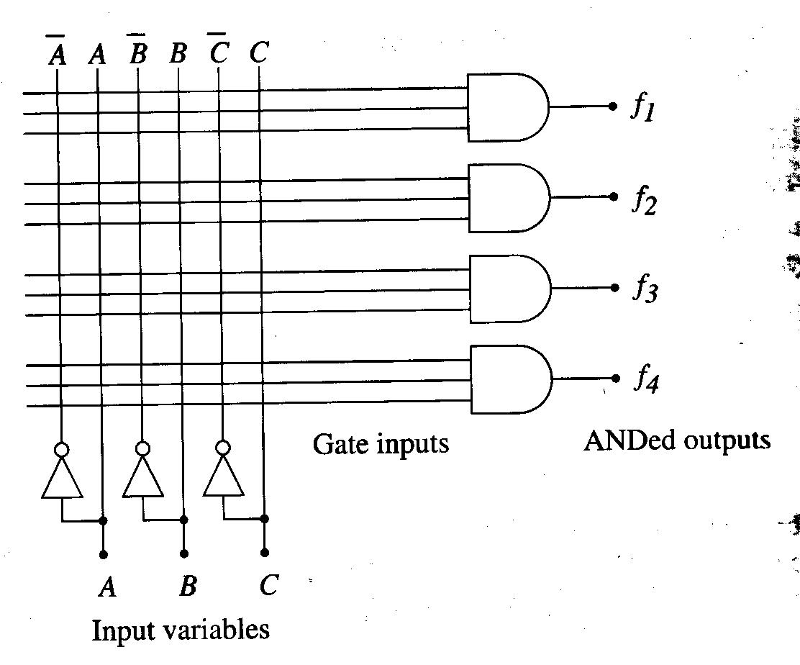
Logic Arrays
Structured networks that can be ________ to produce specific forms of logic expressions.
AND array (________ are used to program it)
Uncommitted AND logic array -> programming (= make __________ accordingly)

Slide 16
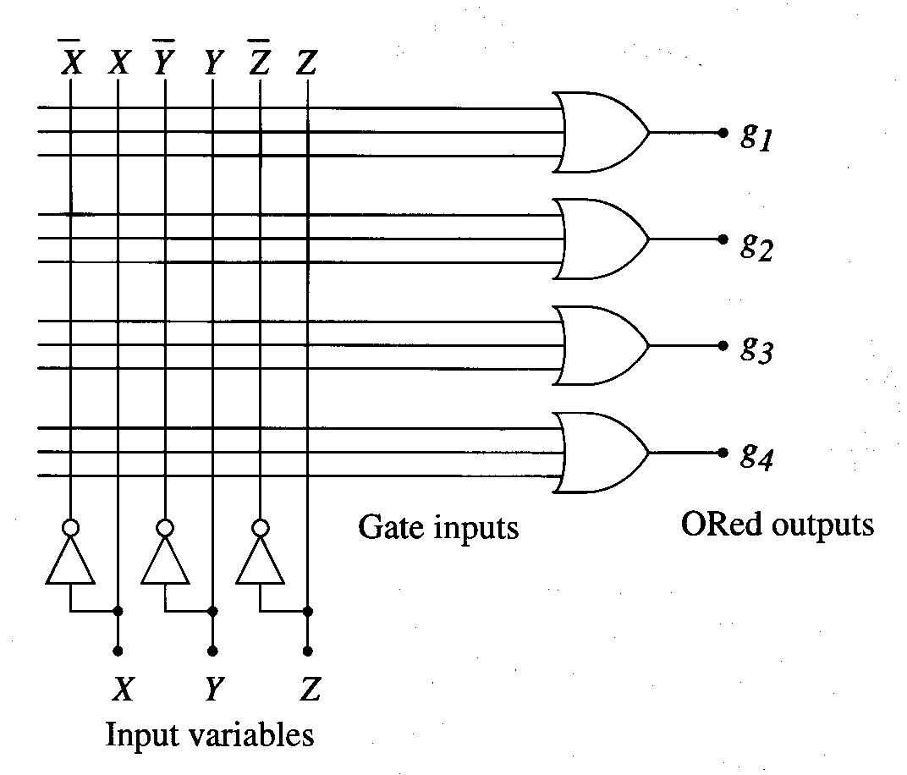
Continued,
OR array (produces ___________)
Ex)
Combine AND & OR array -> SOP & POS arrays.

Slide 17
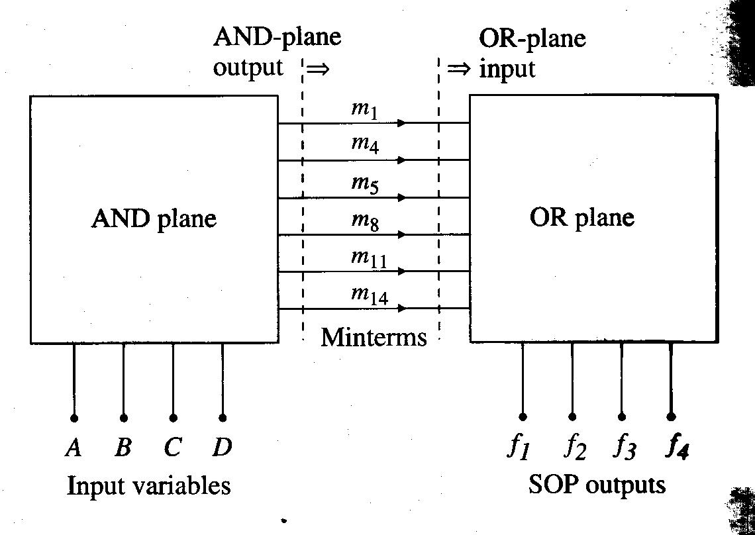
AND-OR PLA (Programmable Logic Array) for SOP

Slide 18
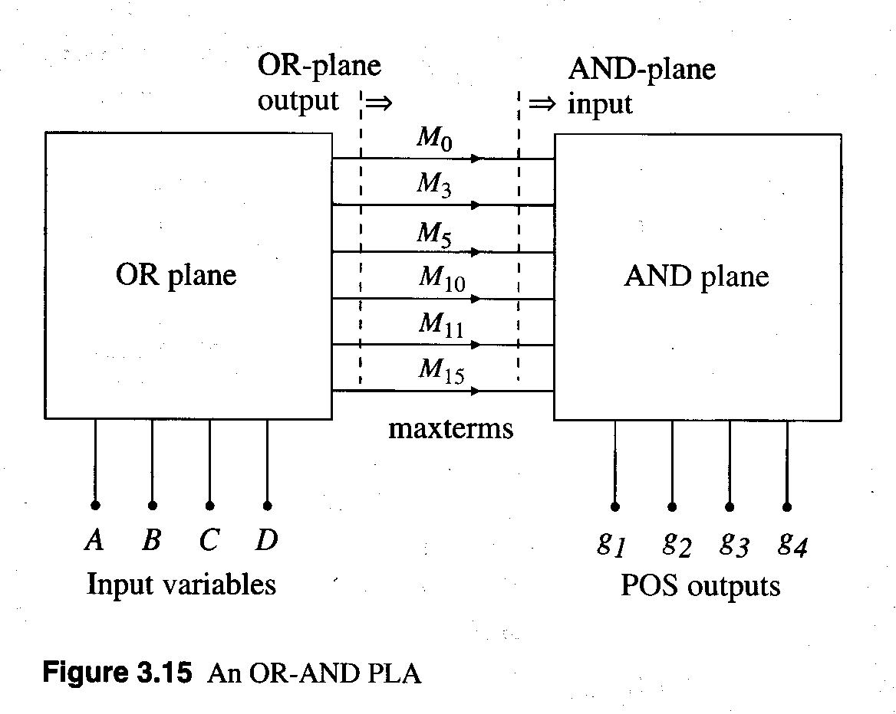
OR-AND PLA for POS

Slide 19
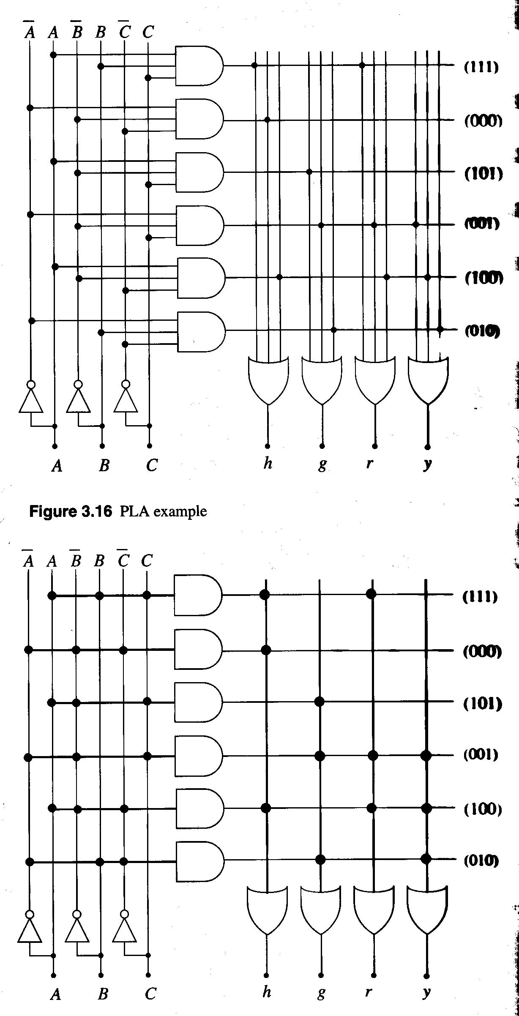
Example

Slide 20
Pros and Cons of Logic Arrays
Pros: Rapid _____________ & ________ of complex digital networks.
Cons: Resulting circuit will probably not be the most efficient use of gates and the design itself will not be the fastest implementation that can be achieved.
Complex PLA-based programmable devices are called PLDs (_______________________).
Good example of PLD: FPGAs (___________________) -> very powerful logic circuits that can be used to implement highly complex logic networks.
CAD tools are used to implement and program custom logic networks on FPGAs.

Slide 21
BCD & 7-Segment Display
_________________ (BCD) is a binary counting system for the base-10 digits 0 through 9 -> 4 bits required & A, B, C, D denote individual bits.
Binary combinations ____ through ____ are not used.

Slide 22
Ex) An application of BCD: BCD to 7-segment decoder.
7-segment display: a common type of numerical display that usually uses 7 LEDs (______________) to represent decimal digits.

Slide 23
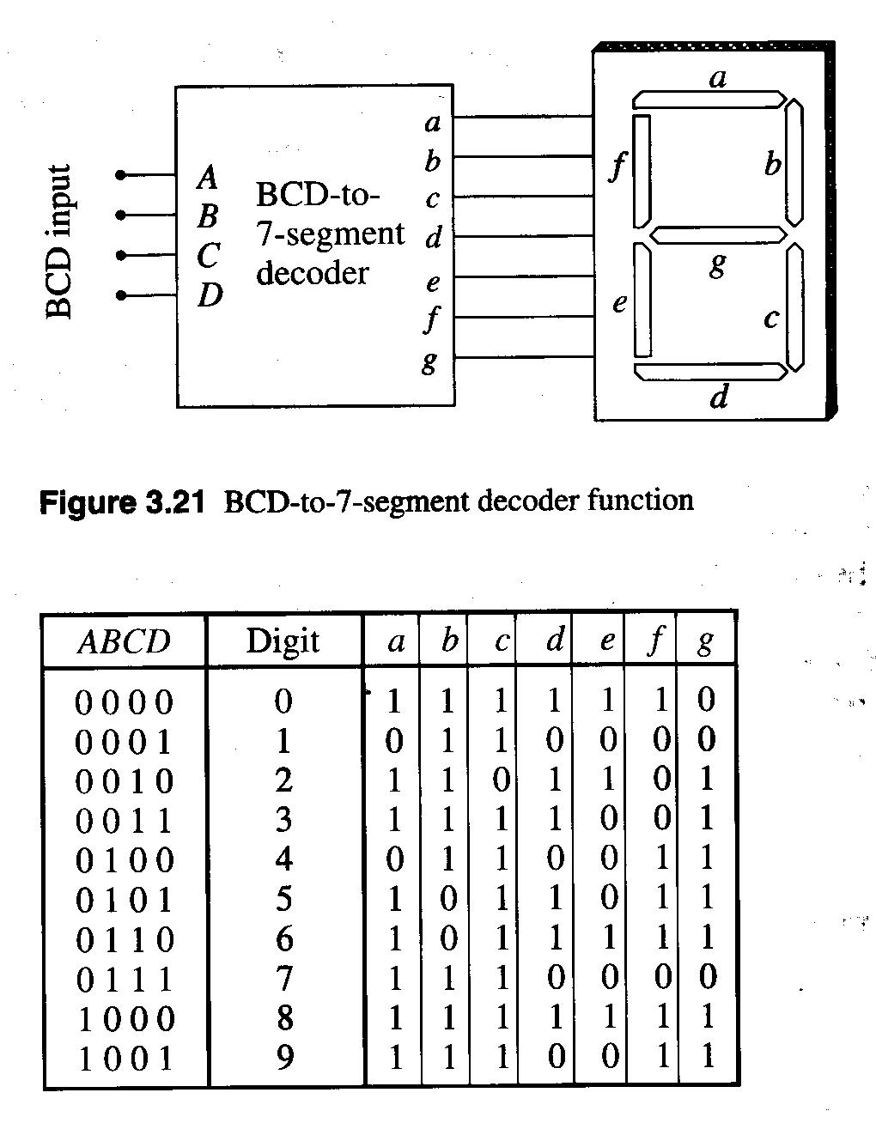
BCD-to-7-Segment Decoder Function
-> decoder has 7 outputs -> 7 functions
  a = a(A,B,C,D)
  b = b(A,B,C,D) ....
SOP expressions?

Slide 24
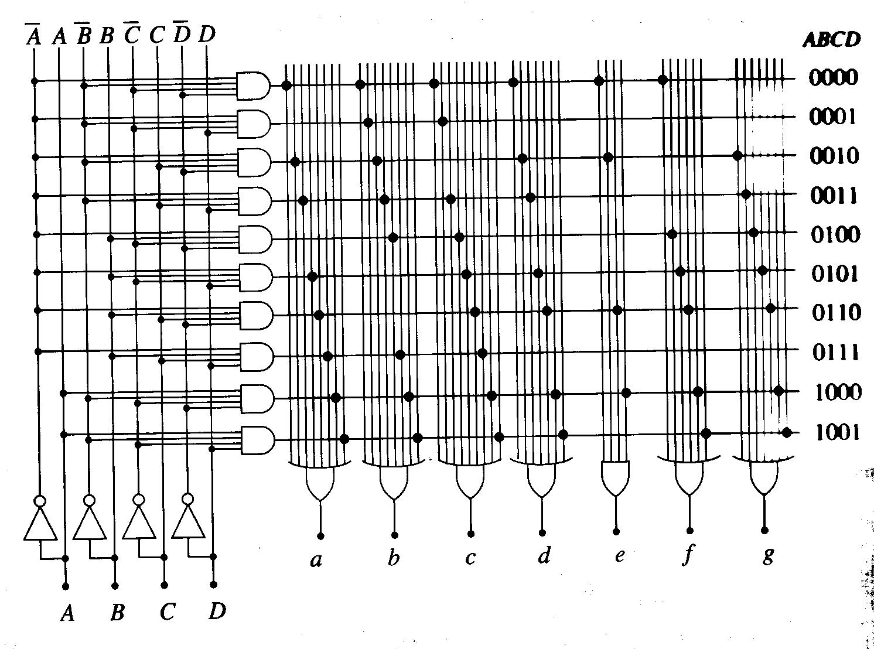
PLA Implementation

Slide 25
Karnaugh Maps (= K-maps)
Canonical SOP & POS forms can be simplified, but the types of gates and their placement in the logic network will be “_______" in that they cannot be predicted -> This design technique is called random logic -> More systematic way? K-maps.
Karnaugh maps allow us to simply Boolean functions using a _____________________ that helps us recognize Boolean reductions by their locations on a grid.
The technique of K-maps relies on the following two identities:
where X is any group of logic variables.

Slide 26
Continued,
Ex)
-> K-maps can do reductions in a systematic way.
Start with a function table.
Map the input-output combinations to a rectangular grid array.
Locate the terms where the identity __________ can be used to simply the function.

Slide 27
Continued,
K-maps can be applied to functions with arbitrary # of variables.
Only 2, 3, and 4-variable cases will be discussed.
For more # of variables, computer programs can be used.

Slide 28
2-Variable K-maps
Express the function in grid-like table.
List all possible minterms & the resulting output value of the function ->
Construct a basic map.
Lookup truth table & construct K-map.
Locate groups of 1, 2 or 4 adjacent 1s and simplify.

Slide 29
Examples

Slide 30
3-Variable K-Maps
Create a map using the variable A with B,C (or A,B with C) so that adjacent boxes differ by only one bit entry.
1, 2, 4 or 8 adjacent 1s can be grouped and reduced.
Left and right edges are also adjacent; allowing us to “_____” the map into a cylinder.

Slide 31
Examples

Slide 32
Summary of Simplification Rules
A group of one minterm gives a term with all three factors A, B and C.
A group of two minterms reduces to a term with two factors.
A group of four minterms reduces to a term with one factor.
A group of all eight minterms is equivalent to a logic 1.

Slide 33
“Don’t Care” Conditions
The output produced by a particular set of inputs can be either 0 or 1 without affecting the behavior of the function -> called “don’t care” condition & denoted by X.
Ex)

Slide 34
Alternative 3-Variable Layout

Slide 35
4-Variable K-Maps
Group A,B and C,D to draw a K-map.
Group 1, 2, 4, 8 or 16 adjacent entries of 1s.
Top-down and left-right edges are adjacent.

Slide 36
Examples

Slide 37
Program Completed
University of Missouri-Rolla
© 2003 Curators of University of Missouri

